Slide 1
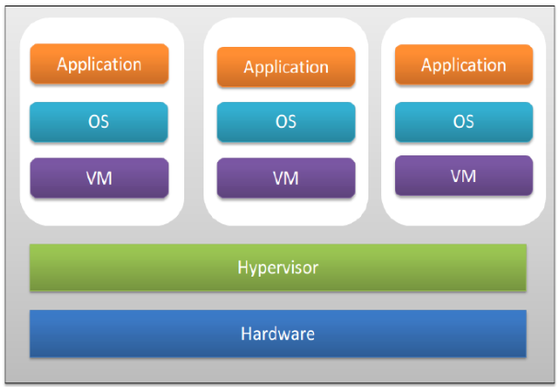
Virtualization
Virtualization is technology that you can use to create virtual representations of servers, storage, networks, and other physical machines.

Slide 2
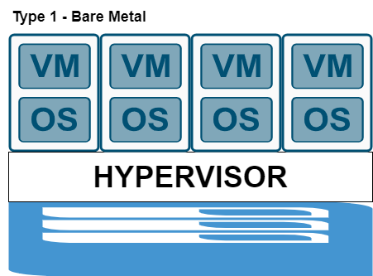
Type 1: Bare Metal

Slide 3
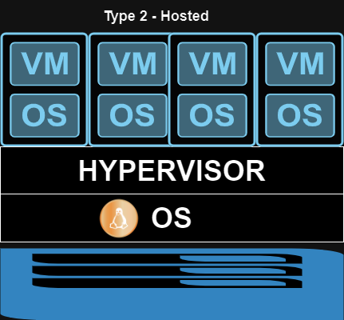
Type 2: Hosted

